Slide 1
Sample Size Estimates for Optical Coherence Tomography Outcome Measures Based on Trends Observed in the SPRINT-MS Trial
SCT 2020
Janel K Fedler, Robert A Bermel, Chris S Coffey, Elizabeth Klingner, Jon Yankey, Robert J Fox

Slide 2
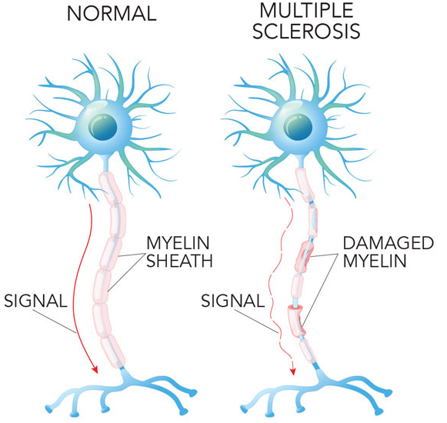
Multiple sclerosis (MS): a disease of the central nervous system in which the immune system attacks the myelin sheath of nerve fibers
Main symptoms affect movement and vision
Treatment to modify disease course, relapses, and manage symptoms
BACKGROUND –MS

Slide 3
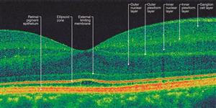
Optical Coherence Tomography (OCT): a non-invasive procedure that uses light waves to measure the thickness of various structures within the retina
OCT parameters decline proportional to disability progression in MS
OCT use in clinical trials:
Frequently used in Ophthalmology
Low cost, easy to perform with minimal patient burden
Requires compatible devices across centers and a specialized reading center
Two main models: Zeiss Cirrus and Heidelberg Spectralis
BACKGROUND – OCT

Slide 4
SPRINT-MS: a prospective, 96 week, phase 2 randomized trial of ibudilast in primary and secondary progressive MS
48% reduction of brain volume loss measured by brain parenchymal fraction, a measure of permanent tissue loss
OCT was included as a key secondary measure
28 Total sites: 22 were certified as Zeiss Cirrus and 6 as Heidelberg Spectralis SD-OCT site
183 participants imaged with Cirrus and 61 with Spectralis
BACKGROUND – SPRINT-MS

Slide 5
OCT outcomes: peripapillary RNFL (pRNFL), macular volume (MV) and ganglion cell-inner plexiform layer thickness (GCIP)
Obtained on both eyes at baseline, week 24, week 48, week 72 and week 96
Rate of change in OCT parameters by treatment group was estimated using a linear mixed model accounting for the correlation within-subject between eyes at each visit and over time
pRNFL – combined model
MV – separate models by device
GCIP – collected in Cirrus only
BACKGROUND – SPRINT-MS
$$Y_{ijk}=β_{0}+β_{1}{strata1}_{i}+β_{2}{strata2}_{i}+$$
$$β_{3}{placebo}_{i}∗{time}_{ijk}+β_{4}{ibudilast}_{i}∗{time}_{ijk}+$$
$$β_{5}{eye}_{ik}+a_{i}+b_{i}∗{time}_{ijk}+ε_{ijk}$$

Slide 6
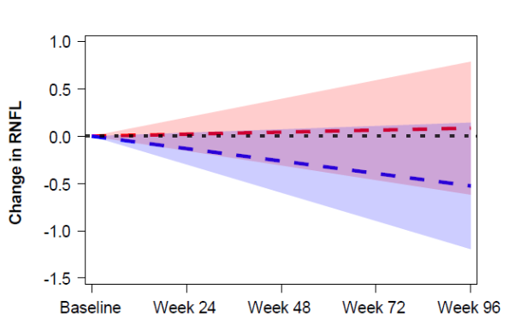
Model Estimated Change in pRNFL

Slide 7
OCT Model Estimates
Outcome Measure | N | Change Per Year Placebo Ibudilast |  | Effect Size | P-value
pRNFL | 244 | -0.2630uM | +0.0424uM | 72% | 0.22
MV - Cirrus | 183 | -0.0208mm³ | -0.0004mm³ | 98% | 0.17
MV - Spectralis | 61 | -0.0366mm³ | -0.0050mm³ | 86% | 0.04
GCIP | 183 | -0.9587uM | -0.4893uM | 49% | 0.12

Slide 8
Simulation to estimate sample sizes needed for 2-arm trials for the OCT outcome measures based on trends observed in the SPRINT-MS trial
Varied the treatment effect estimate to achieve selected effect sizes for the percentage in slope reduction relative to placebo
effect size $=\frac{placebo slope− treatment slope}{placebo slope}$
Power was estimated by the percent of times out of r=1000 replications that the p-value for the test of equal slopes between treatment groups was below the designated alpha level
Grid search method used to estimate the sample size that would achieve the desired power
Methods

Slide 9
Sample sizes for 2-arm trials based on trends observed in the NN102 progressive MS trial to achieve 80% power and 10% type I error
Outcome Measure | Effect Size 50% 60% 70% 80%
pRNFL | >9500 | 7336 | 5490 | 4050
MV - Cirrus | 1950 | 1370 | 1054 | 852
MV - Spectralis | 270 | 204 | 172 | 140
GCIP | 386 | 264 | 196 | 152

Slide 10
GCIP Measures Yearly vs Every 6 Months
Frequency | Effect Size 50% 60% 70% 80%
6 Months | 386 | 264 | 196 | 152
Yearly | 490 | 350 | 254 | 198
30% increase in sample size by
increasing the scan interval to yearly

Slide 11
SPRINT-MS was the 1st multicenter progressive MS trial employing OCT as an outcome in all enrolled subjects
Based on trends from SPRINT-MS, OCT may be a viable outcome measure in future trials for therapies with large effects
Preplanning GCIP as the primary outcome measure requires advanced analytics validated across different acquisition platforms
Methods to reduce noise and increase ability to detect treatment effect between groups:
Increasing standards for scan quality
Adding assessment time points
Changing inclusion criteria to enrich for more active patients with more rapid change over time
Investigating alternative OCT outcomes
Conclusions and Future Work

Slide 12
References
American Academy of Ophthalmology. OCT image of normal retina with layers labeled [digital image]. https://www.aao.org/eye-health/treatments/what-is-optical-coherence-tomography. Accessed July 22, 2020.
The National Multiple Sclerosis Society. https://www.nationalmssociety.org/What-is-MS/Definition-of-MS. Accessed July 22, 2020.
Beaumont. MS nerve cells [digital image]. Retrieved from https://www.beaumont.org/images/default-source/neuro/ms-nerve-cells.jpg?sfvrsn=b77c97e3_0
Bermel R, Fedler J, Kaiser P, Novalis C, Schneebaum J, Klingner e, Williams D, Yankey J, Ecklund D, Chase M, Naismith R, Klawiter E, Goodman A, Coffey C, Fox R. Optical Coherence Tomography Outcomes from SPRINT-MS, a multicenter, randomized, double-blind trial of ibudilast in progressive Multiple Sclerosis. Under Review.
Fox RJ, Coffey CS, Conwit R, et al. Phase 2 Trial of Ibudilast in Progressive Multiple Sclerosis. New Engl J Med 2018; 379: 846-855. DOI: 10.1056/NEJMoa1803583.
R Core Team. R: A language and environment for statistical computing. 2019.
Saidha S, Al-Louzi O, Ratchford JN, et al. Optical coherence tomography reflects brain atrophy in multiple sclerosis: A four-year study. Ann Neurol. 2015;78(5):801-813. DOI:10.1002/ana.24487.
Syc SB, Warner CV, Hiremath GS, et al. Reproducibility of high-resolution optical coherence tomography in multiple sclerosis. Mult Scler 2010; 16: 829-839. 2010/06/10. DOI: 10.1177/1352458510371640.
Sotirchos ES, Gonzalez Caldito N, Filippatou A, et al. Progressive Multiple Sclerosis Is Associated with Faster and Specific Retinal Layer Atrophy. Ann Neurol. 2020;87(6):885-896. DOI:10.1002/ana.25738

